Slide 1
SWE-4805: Software Verification and Validation
Introduction
Md. Nazmul Haque
Lecturer, IUT
Department of Computer Science and Engineering
Islamic University of Technology
November 26, 2021

Slide 2
Contents
Contents
Introduction to Alloy

Slide 3
Alloy
Example: Family Structure
Model parent/child relationships as primitive relations
Model spousal relationship as primitive relations
Model relationships such as “siblings” as derived relations
Enforce certain biological constraints via 1st order predicates
(e.g., people have only one mother)
Enforce certain social constraints via 1st order predicates
(e.g., a wife isn’t a sibling)
Confirm the existence of certain derived relationships
(e.g., no one has a wife with whom he shares a parent)

Slide 4
Alloy
Atoms and Relations
In Alloy, everything is built from Atoms and Relations.
An atom is a primitive entity that is-
Indivisible: it cannot be broken down into smaller parts
Immutable: its properties do not change over time
Uninterpreted: it does not have any built-in property (the way numbers do, for example)
A relation is a structure that relates atoms. It is a set of tuples, each tuple being a sequence of atoms.

Slide 5
Alloy
Main components of Alloy model
Signatures
Fields
Predicates
Functions
Facts
Assertions
Command and scopes

Slide 6
Alloy
Signatures
A signature introduces a set of atoms. A signature named A can be declared as
sig A{}
Even, a set can be introduced as an extension of another; thus
sig A1 extends A{}
introduces a set A1 that is a subset of A.

Slide 7
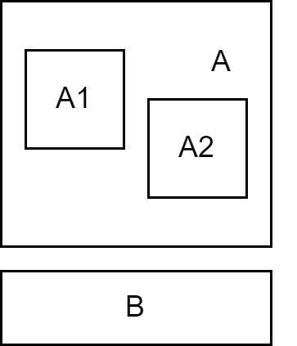
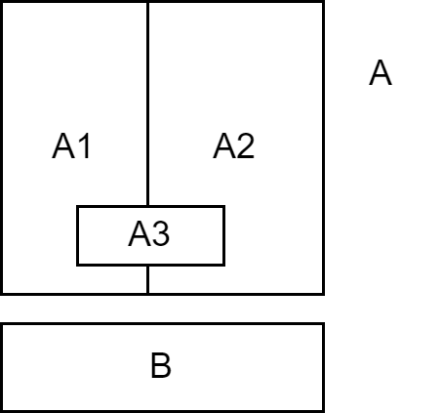
Alloy
Signatures
1.
sig A {}
sig B {}
sig A1 extends A {}
sig A2 extends A {}
2.
abstract sig A {}
sig B {}
sig A1 extends A {}
sig A2 extends A {}
sig A3 in A {}

Slide 8
Alloy
Fields
Relations are declared as fields of signatures.
sig A { f: e}
It introduces a relation f of type A x e, where e is an expression denoting a product of signatures. Some examples of signatures A, B, C are-
Binary Relation: sig A { f1: B} // subset of A x B
Ternary Relation: sig A { f2: B -> C } // subset of A x B x C

Slide 9
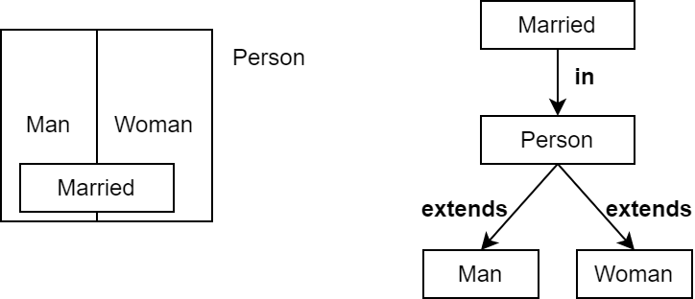
Alloy
Family Structure
abstract sig Person {
Children: Person,
Siblings: Person
}
sig Man, Woman extends Person {}
sig Married in Person {
spouse: Married
}

Slide 10
Alloy
Multiplicity
There are four multiplicities
set: any number
some: one or more
lone: zero or one
one: exactly one
The default multiplicity is one.
1. Multiplicity on sig: m sig A {}
2. Multiplicity on fields:
sig A { f: m e}
sig A { f: e1 m -> n e2}
Multiplicities can also be applied to whole expressions denoting relations

Slide 11
Alloy
Family Structure with Multiplicity
abstract sig Person {
Children: set Person,
Siblings: set Person
}
sig Man, Woman extends Person {}
sig Married in Person {
spouse: one Married
}

Slide 12
Alloy
Logical Operators
not (!) Negation
and (&&) conjunction
or (||) disjunction
implies (=>) implication
else alternatives
⇔ equivalence

Slide 13
Alloy
Quantifiers
all x: S | F F holds for every x in S
some x: S | F F holds for some x in S
no x: S | F F holds for no x in S
lone x: S | F F holds for at most one x in S
one x: S | F F holds for exactly one x in S

Slide 14
Alloy
Set Operators
Everything is a set in Alloy
+ union
& intersection
- difference
in subset
= equality
!= disequality
Married Men: Married & Man

Slide 15
Alloy
Relational Operators
-> arrow (cross product)
~ transpose
. dot join
[] box join
^ transitive closure
* reflexive-transitive closure
<: domain restriction
:> image restriction
++ override

Slide 16
Alloy
Arrow (Cross Product)
p -> q
p and q are two relations
It is a relation you get by taking every combination of a tuple from p and a tuple from q and concatenating them.
Example
Name = { (N0), (N1) }
Addr = { (D0), (D1) }
Book = { (B0)}
Name ->Addr = {(N0,D0),(N0,D1),(N1,D0),(N1,D1)}
Book -> Name -> Addr =
{(B0,N0,D0),(B0,N0,D1),(B0,N1,D0),(B0,N1,D1)}

Slide 17
Alloy
Transpose
~ p
Take the mirror image of the relation p, i.e., reverse the order of atoms in each tuple
Example:
p = {(a0,a1,a2,a3),(b0,b1,b2,b3)}
~p = {(a3,a2,a1,a0),(b3,b2,b1,b0)}
What does it mean: ~children

Slide 18
Alloy
Relational Composition (Join)
p.q
p and q are two relations that are not both unary
It is a relation you get by taking every combination of a tuple from p and a tuple from q and adding their join, if it exists.
Join mechanism
(a₁,a₂,....,a_{m})
(b₁,b₂,....,b_{n})
If a_{m} != b₁, then the join is undefined
If a_{m} =b₁ then it is: (a₁,a₂,....,a_{m-1},b₂,....,b_{n})

Slide 19
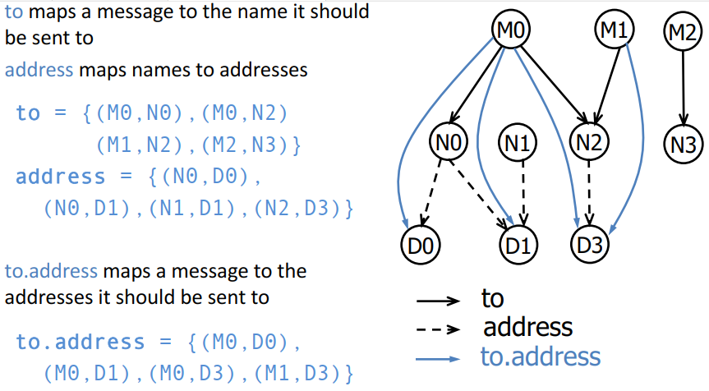
Alloy
Relational Composition (Join)
Examples

Slide 20
Alloy
Questions regarding Family Structure
How would you use join to find Matt’s children or grandchildren?
Matt.children
Matt.children.children
Every married man (woman) has a wife (husband)
all p: Married |
(p in Man => p.spouse in Woman)
and
(p in Woman => p.spouse in Man)
A spouse can’t be a sibling
no p: Married | p.spouse in p.siblings

Slide 21
Alloy
Box Join
p[q]
Semantically identical to dot join, but takes its arguments in different order
p[q] ≡ q.p
Matt’s children or grandchildren?
children[Matt]
children[children[Matt]]

Slide 22
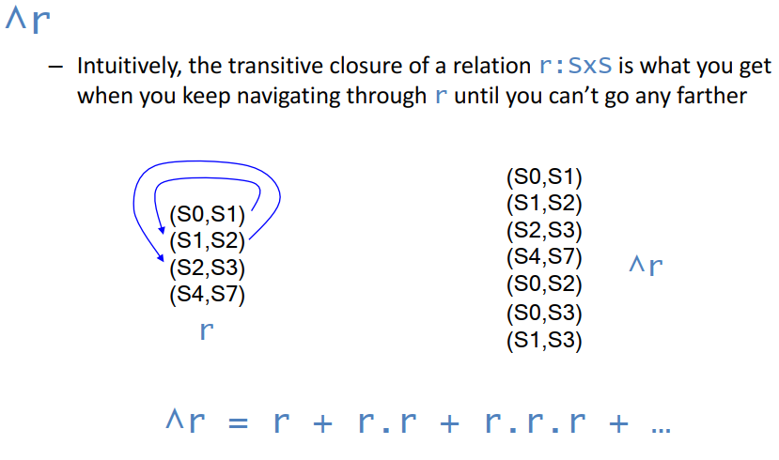
Alloy
Transitive Closure

Slide 23
Alloy
Transitive Closure
Examples
Matt’s descendants or ancestors
Matt.^children
Matt.^(~children)
No person can be their own ancestor
no p: Person | p in p.^(~children)

Slide 24
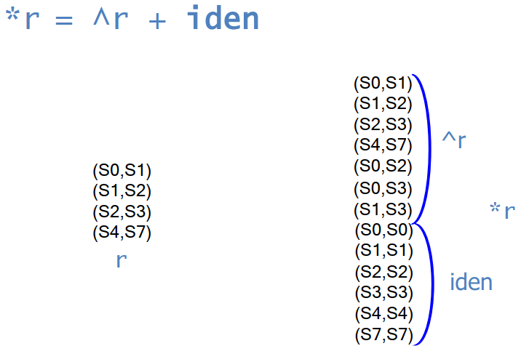
Alloy
Reflexive-Transitive Closure

Slide 25
Alloy
Domain and Image Restrictions
The restriction operators are used to filter relations to a given domain or image
If s is a set and r is a relation, then
s <: r contains tuples of r starting with an element in s
r :> s contains tuples of r ending with an element in s
Examples
Man = {(M0),(M1),(M2),(M3)}
Woman = {(W0),(W1)}
children = {(M0,M1),(M0,M2),(M3,W0),(W1,M1)}
Man <: children = {(M0,M1),(M0,M2),(M3,W0)} //father-child
children :> Man = {(M0,M1),(M0,M2),(W1,M1)} // parent-son

Slide 26
Alloy
Override
p ++ q
p and q are two relations of arity two or more
The result is like the union between p and q except that tuples of q can replace tuples of p; any tuple in p that matches a tuple in q starting with the same element is dropped.
p ++ q = p – (domain(q) <: p) + q
Example
oldAddr = {(N0,D0),(N1,D1),(N1,D2)}
newAddr = {(N1,D4),(N3,D3)}
oldAddr ++ newAddr = {(N0,D0),(N1,D4),(N3,D3)}

Slide 27
Alloy
Operator precedence
Lower to Higher
||
⇔
=>
&&
!
= != in
+ -
++
&
->
<:
:>
[]
.
~ * ^

Slide 28
Alloy
Family Structure
Constraints
No person can have more than one father and mother
all p: Person | (lone (children.p & Man)) and (lone (children.p & Woman))
all p: Person | (lone (Man <: children).p) and (lone (Woman <: children).p)
A person P’s siblings are those people, other than P, with the same parents as P
all p: Person | p.siblings = {q: Person | p.parents = q.parents} - p

Slide 29
Alloy
Facts
Additional constraints on signatures and fields are expressed in Alloy as facts
fact Name {
F1
F2
…
}
AA looks for instances of a model that also satisfy all of its fact constraints

Slide 30
Alloy
Facts
Examples
No person can be their own ancestor
fact selfAncestor {
no p: Person | p in p.^parents
}
a persons's siblings are other persons with the same parents
fact siblingsDefinition {
all p: Person | p.siblings = {q: Person | p.parents = q.parents} - p
}

Slide 31
Alloy
Run Command
Limits the size of instances considered to make instance finding feasible
run {} // The scope of every signature is 3
run {} for 5 // The scope of every signature is 5
run pred // pred is a predicate

Slide 32
Alloy
Assertion
The constraints are defined as assertions and ask the AA to check if they hold.
If the constraint in an assertion does not hold, the analyzer will produce a counterexample instance
assert assertName { some constraints}
check assertName
Example: No person has a parent that is also a sibling
assert a1 { all p: Person | no p.parents & p.siblings }
check a1

Slide 33
Alloy
Predicates and Functions
Parametrized macros for terms and formulas
Can be named and reused in different contexts (facts, assertions and conditions of run)
Can have zero or more parameters
Used to factor out common patterns
Functions are good for:
set expressions you want to reuse in different contexts
Predicates are good for:
formulas you want to reuse in different contexts

Slide 34
Alloy
Functions
A named set expression, with zero or more parameters
Example: The sisters function
fun sisters [p: Person] : Woman { {w: Woman | w in p.siblings} }

Slide 35
Alloy
Predicates
A predicate is like a programming function that returns a boolean.
Examples
Two persons are blood relatives iff they have a common ancestor
pred BloodRelated [p: Person, q: Person] { some (p.*parents & q.*parents) }
A person can't be married to a blood relative
no p: Married | BloodRelated[p, p.spouse]

Slide 36
ANY QUESTION ?
THANK YOU !

Slide 37
Acknowledgements
Acknowledgements
[1] Marcus S. Fisher, Software Verification and Validation: An Engineering and Scientific Approach, Springer, 2007 edition, 2006.
[2] Chauhan, Naresh. Software Testing: Principles and Practices. Oxford university press, 2010.
[3] Department of Software Engineering, University of Iowa.

